Slide 1

Introduction of Computer Network
Dr. Kamlesh Chandravanshi
VIT, Bhopal
School of Computer Science & Engineering

Slide 2
UNIT-1 Content
Basics of Computer Networking
Goals of Networks
The Advantages/Uses of Network
The Networking Devices(Nodes)

Slide 3
Basics of Computer Networking
Open system: A system which is connected to the network and is ready for communication.
Closed system: A system which is not connected to the network and can’t be communicated with.

Slide 4
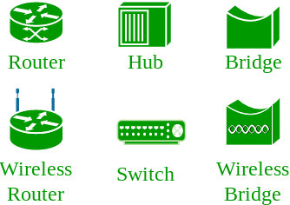
Computer Network:
An interconnection of multiple devices, also known as hosts, that are connected using multiple paths for the purpose of sending/receiving data or media. Computer networks can also include multiple devices/mediums which help in the communication between two different devices; these are known as Network devices and include things such as routers, switches, hubs, and bridges.

Slide 5
Networking Elements
Computer Network means an interconnection of autonomous (standalone) computers for information exchange. The connecting media could be a copper wire, optical fiber, microwave, or satellite.
Networking Elements – The computer network includes the following networking elements:
At least two computers
Transmission medium either wired or wireless
Protocols or rules that govern the communication
Network software such as Network Operating System

Slide 6
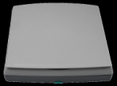


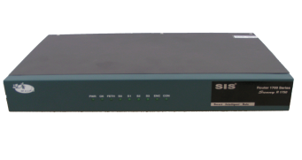
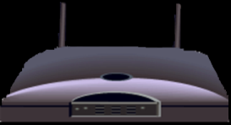
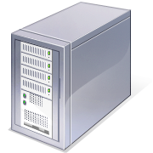
The Network Diagram
Wired Network
PC
Firewall
The Internet
Fiber Optic Network Cable
Router
Switch
Server
Other LANS
Wireless Network

Slide 7
Network Criteria
Network Criteria:
The criteria that have to be met by a computer network are:
1. Performance – It is measured in terms of transit time and response time.
Transit time is the time for a message to travel from one device to another
Response time is the elapsed time between an inquiry and a response.
Performance is dependent on the following factors:
The number of users
Type of transmission medium
Capability of connected network
Efficiency of software

Slide 8
2. Reliability – It is measured in terms of
Frequency of failure
Recovery from failures
Robustness during catastrophe
3. Security – It means protecting data from unauthorized access.

Slide 9
Goals of Computer Networks
The following are some important goals of computer networks:
Resource Sharing
Many organization has a substantial number of computers in operations, which are located apart. Ex. A group of office workers can share a common printer, fax, modem, scanner, etc.
High Reliability
If there are alternate sources of supply, all files could be replicated on two or more machines. If one of them is not available, due to hardware failure, the other copies could be used.

Slide 10
Inter-process Communication
Network users, located geographically apart, may converse in an interactive session through the network. In order to permit this, the network must provide almost error-free communications.
Flexible access
Files can be accessed from any computer in the network. The project can be begun on one computer and finished on another. Other goals include Distribution of processing functions, Centralized management, and allocation of network resources, Compatibility of dissimilar equipment and software, Good network performance, Scalability, Saving money, Access to remote information, Person to person communication, etc.

Slide 11
The Advantages/Uses of Network
Simultaneous Access
There are moments in any business when several workers may need to use the same data at the same time.
Shared Peripheral Devices
Personal Communications
Videoconferencing
Voice over Internet Protocol (VoIP):-VoIP transmits the sound of voice over a computer network using the Internet Protocol (IP ) rather than sending the signal over traditional phone wires
Easier Data Backup

Slide 12
The Networking Devices(Nodes)
NIC Card(ethernet card) (wired network)
Repeater
Hub
Switch
Bridge
Router
Gateway
Firewall
Medium(Wired/Wireless)

Slide 13
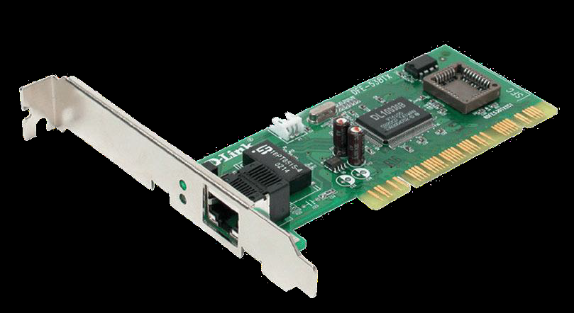
Network Interface Card
NIC is used to physically connect host devices to the network media.
A NIC is a printed circuit board that fits into the expansion slot of a bus on a computer motherboard.
It can also be a peripheral device. NICs are sometimes called network adapters.
Each NIC is identified by a unique code called a Media Access Control (MAC) address.
This address is used to control data communication for the host on the network.
(Physical address of the device in the network) ABCD:1023:CDEF(why important) (ABCD:1023:CDEF) (Security purpose)

Slide 14
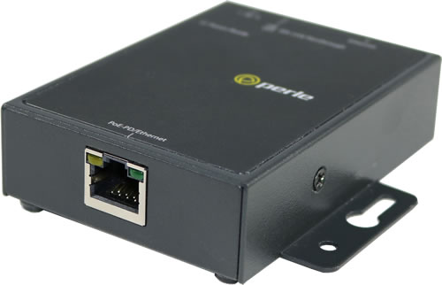
Repeaters
A repeater is a network device used to regenerate a signal.
Repeaters regenerate analog or digital signals that are distorted by transmission loss due to attenuation.
A repeater does not make an intelligent decision concerning forwarding packets

Slide 15
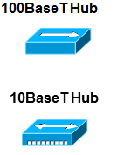
Hubs
Hubs concentrate on connections.
In other words, they take a group of hosts and allow the network to see them as a single unit. This is done passively, without any other effect on the data transmission.
Active hubs concentrate hosts and also regenerate signals.

Slide 16
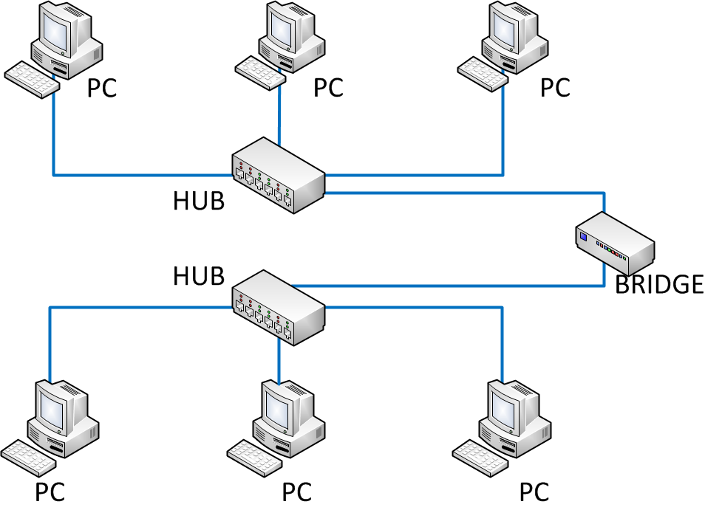
Bridges
Bridges convert network data formats and perform basic data transmission management.
Bridges provide connections between LANs.
They also check data to determine if it should cross the bridge. This makes each part of the network more efficient

Slide 17
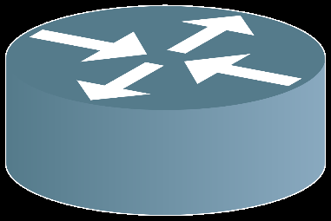
Router [network layer]
Routers have all the capabilities listed above.
Routers can regenerate signals, concentrate multiple connections, convert data transmission formats, and manage data transfers.
They can also connect to a WAN, which allows them to connect LANs that are separated by great distances.

Slide 18
LAN 1 12.0.0.0 Router ← ISP (Indore)
LAN2 (120.1.1.0)
(120.1.1.15)
LANn (
Bhopal

Slide 19
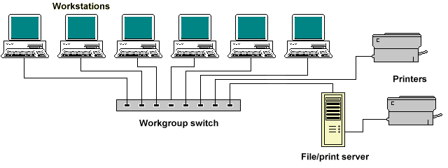
Switches
Switches add more intelligence to data transfer management.
They can determine if data should remain on a LAN and transfer data only to the connection that needs it.
Another difference between a bridge and switch is that a switch does not convert data transmission formats

Slide 20
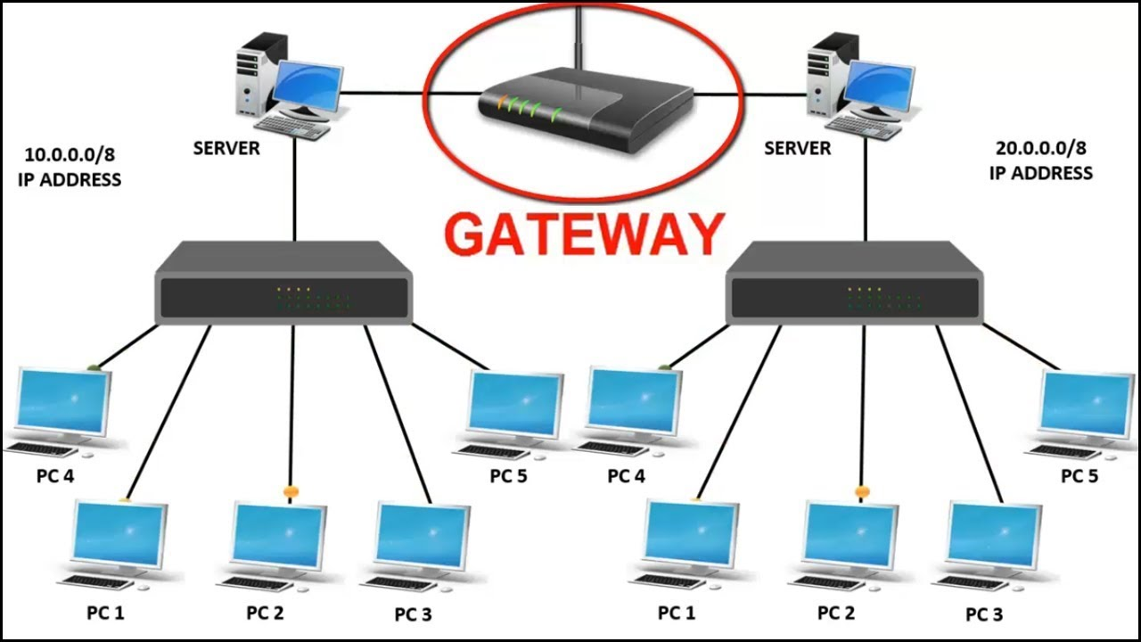
Gateway
A gateway is a piece of networking hardware used in telecommunications for telecommunications networks that allows data to flow from one discrete network to another.
Gateways are distinct from routers or switches in that they communicate using more than one protocol to connect a bunch of networks

Slide 21
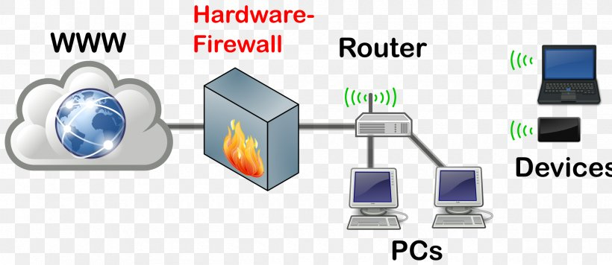
Firewall
A firewall is a network device or software for controlling network security and access rules.
Firewalls are inserted in connections between secure internal networks and potentially insecure external networks such as the Internet.
Firewalls are typically configured to reject access requests from unrecognized sources while allowing actions from recognized ones.
The vital role firewalls play in network security grows in parallel with the constant increase in cyber attacks.

